Slide 1


Trajectory Recovery System: STALL guidance for Inflight Loss of Control:
Complexity in Design and Integration
Nikhil Badri
Complexity Analysis
Human-Centered Design
Notes:
TRS system: the flight looses its trajectory when it is in a stall. so this system helps as a guidance for the pilot to recover the flight from stall and stabilize the flight and get back to flight trajectory.
This is a common work with Nich, which I am working on the simulation part

Slide 2
Problem Statements:
In flight loss of control (ILOC) is the leading cause of aviation fatalities
Claims over 1500 lives in 2002-2012
Significant number of ILOC accidents are due to aerodynamic stall
Over 80% of ILOC accident happen close to ground , demanding accurate & timely recovery

Slide 3
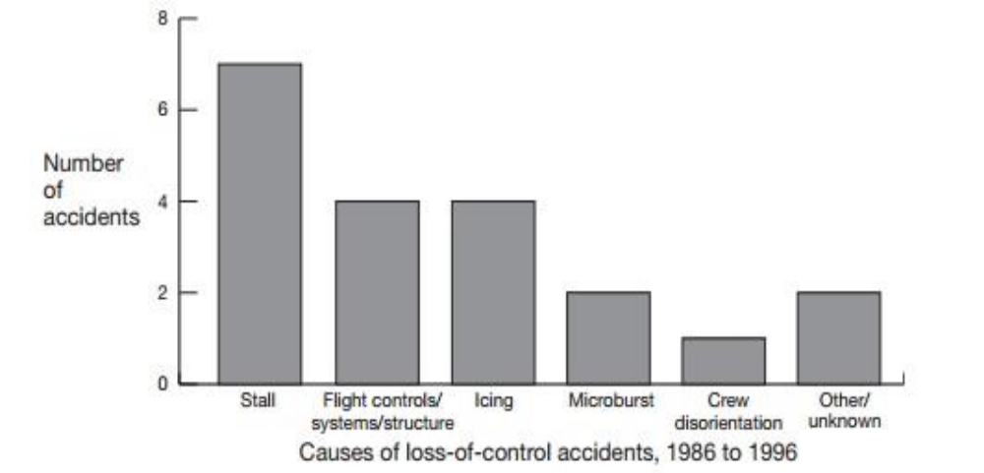
Figure Reproduced from Airplane Upset Recovery Training Aid Rev. 2 (2008)
“Aircraft loss of control causal factors and mitigation challenges” by S. Jacobson 2010
Notes:
According to reports, most of the ILOC accidents are due to aerodynamic stalls.
Ref: Aircraft loss of control causal factors and mitigation challenges by S. Jacobson in 2010

Slide 4
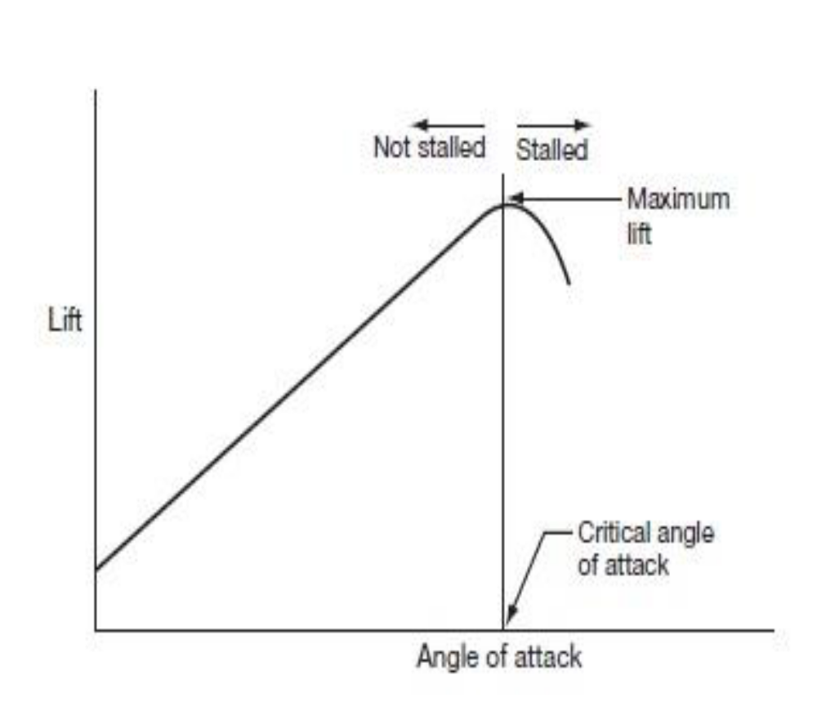
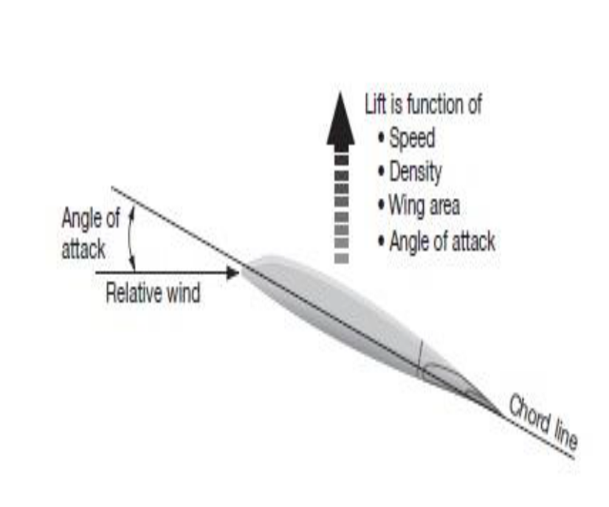
stall
Nicholas Kasdaglis, “ Trajectory Recovery System AIM/ODM solution”
Notes:
A jet aircraft requires lift. Lift is produced as the angle of attack of a wing is increased.
This linearity increases continues to a point known as the critical angle of attack. After this point
an increase in the angle of attack will result in a rapid decrease of lift; a stall
AOA, is the angle between the chord line of the wing and relative wind.

Slide 5
AOA Complexity:
Design and Prototype
  Models
    Number of Parameters (pitch, roll, yaw)
    Dynamics (mass, velocity , density, lift, drag)
  Simulation Tool ( VAPS XT)
Integration
  Interaction devices (Saitek)
  HCDi Simulator Environment
Notes:
Complexity:
Flight is a complex system, as it has many parameters and dynamics to understand
And to Design a prototype considering these parameters (p,r,y) and dynamics (m,v,d,l,d) is complex
VAPS XT is a tool
Integrating the system with the inputs which are these parameters and this is dependent on the feedback.

Slide 6
Proposed Solution N.K.:
Stall Indication system
Trajectory recovery system
  Desired AOA
  Desired power (air speed)
Notes:
There are 2 solution proposed by Nicholas Kasdaglis to minimize this situation:
Stall indication and warning
A recovery system – in this system 2 things are to be achieved : a. reduce AOA, b. required air speed to recover from the stall condition.

Slide 7
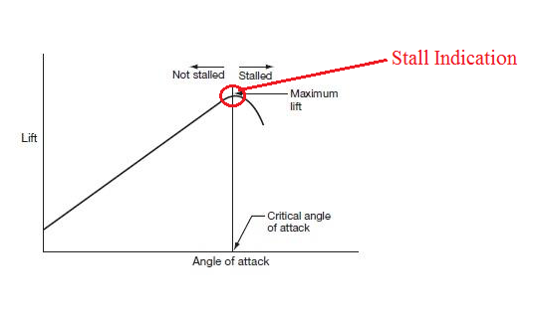
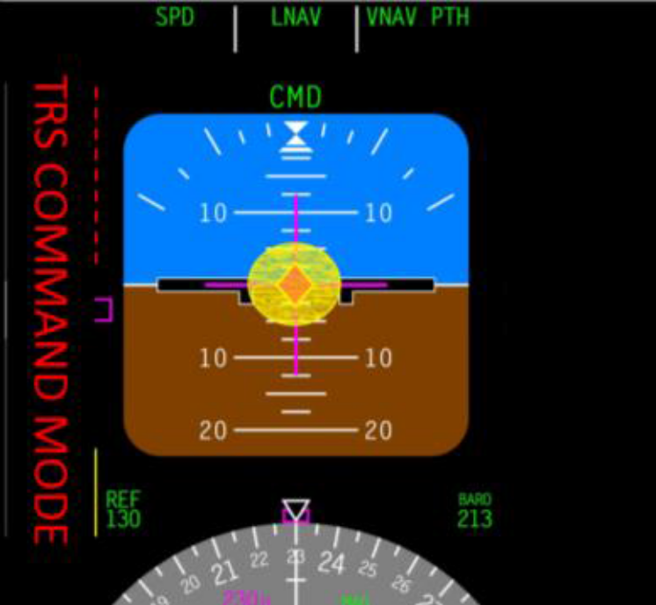
Stall Indication
Notes:
When the wings are about to reach the critical AOA, warning system alerts the pilot and indicates him as shown above in attitude indicator and the TRS system is activated.

Slide 8
Trajectory Recover System
Recovering from stall condition
  Reduce AOA
    Adjusting the Attitude
      Pitch
      Roll
  Adjusting the Thrust
    Power setting
Setting flight back in flight path
Notes:
TRS is all about guiding the pilot to recover the plane from the stall condition and help him in the setting the plane back to its flight path.

Slide 9
Simulation
My work: simulation using VAPS XT
VAPS XT:
  flexible C++ object-oriented HMI modeling tool.
  provides a rapid prototyping, design, and deployment environment for the creation of 2D and 3D photorealistic graphical displays
Notes:
My work is to simulate this human-machine interface system, in order to test system and finding the last minute discrepancies before manufacturing interfacing this system to the cockpit. The simulation tool used is VAPS XT which is based on c++ object-oriented human-machine interface model. A prototype can be designed using this tool.

Slide 10


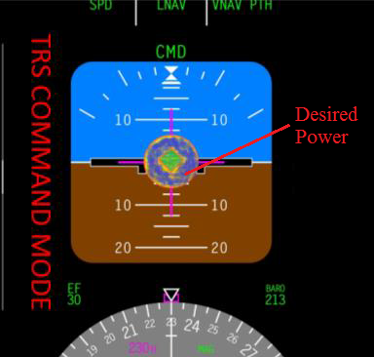
Visualization Design
Notes:
This is the proposed design
Red inner color indicates to reduce the AOA and turns green on achieving the desired AOA
Outer yellow color indicated the power (increase) and turns blue on desired power (thrust on wings)

Slide 11
Visualization Design
Iterative process
  Four designs
  Each design was reviewed
  Feedback led to next design
Notes:
Designing was a complex and is evolving
It is a iterative process which underwent 4 stages in designing
Every stage was reviewed by Dr. Boy, Dr. Lucas, and Nic
They gave several feedbacks and inputs, which led to next design

Slide 12
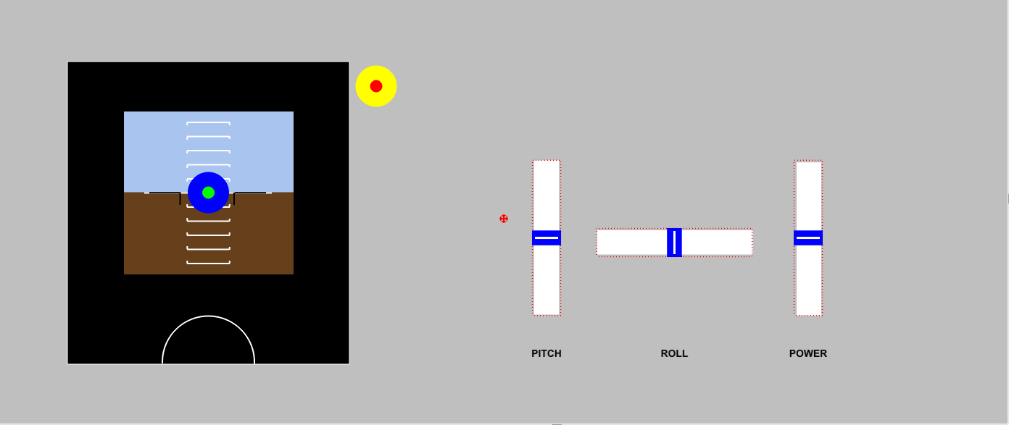
Prototype Design: 1st stage
Notes:
First stage of design
This is simple and is only the TRS mode
Flight director with sliders for pitch, roll and power
Yaw isn’t considered for this design, in future works

Slide 13
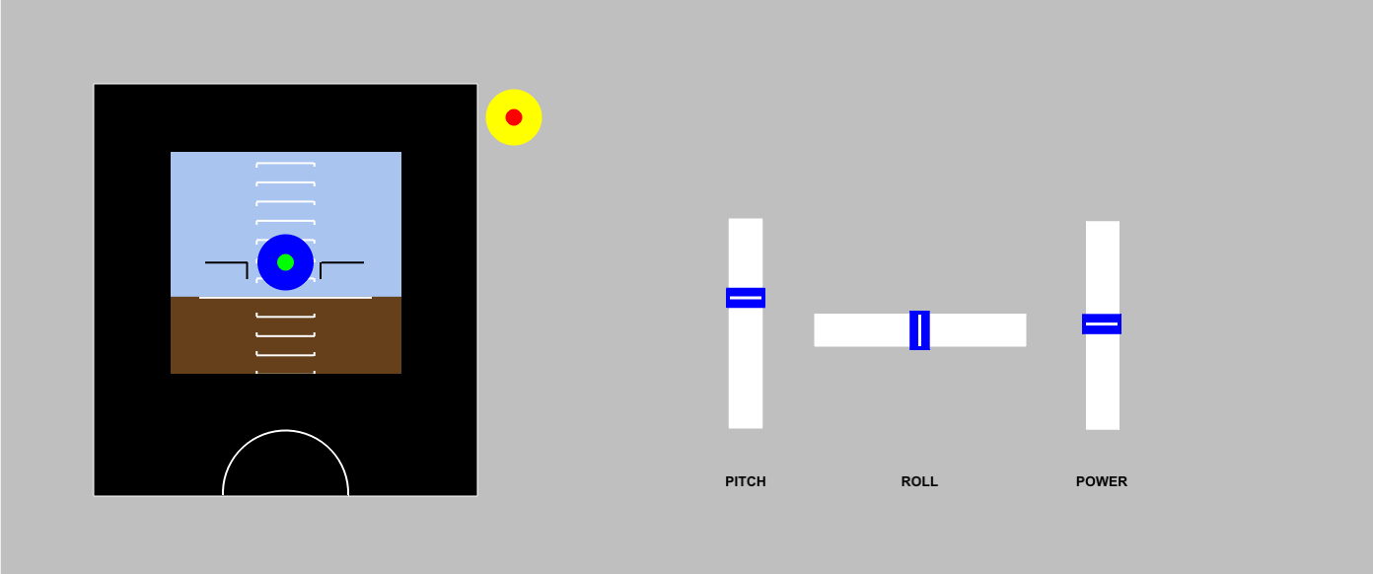
Prototype Design: interactive pitch
Notes:
Testing with the pitch

Slide 14
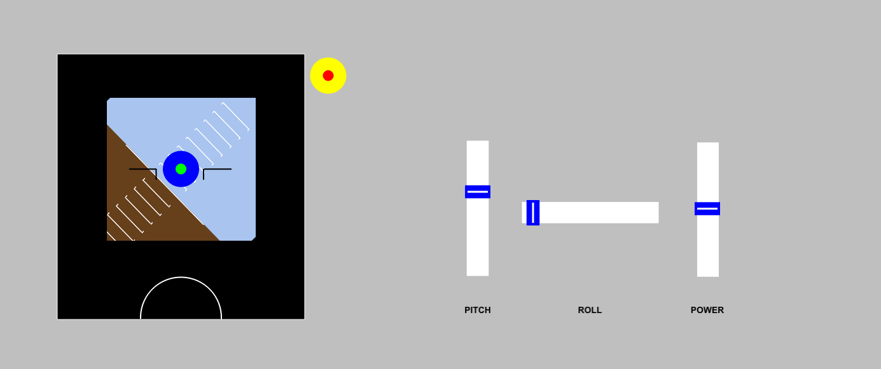
Prototype Design: interactive roll
Notes:
Testing with the roll

Slide 15
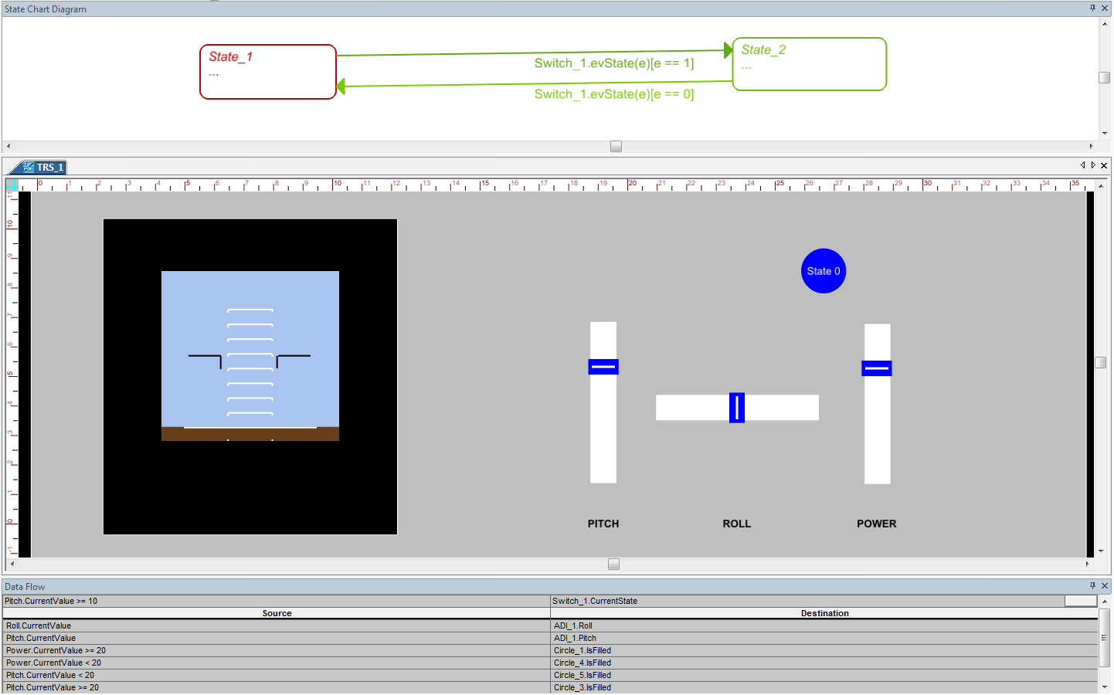
Prototype Design: 2nd stage
State chart diagram
Notes:
State diagram were implemented in order to have 2 states:
Normal mode
TRS mode
A switch is considered to move b/w the states

Slide 16
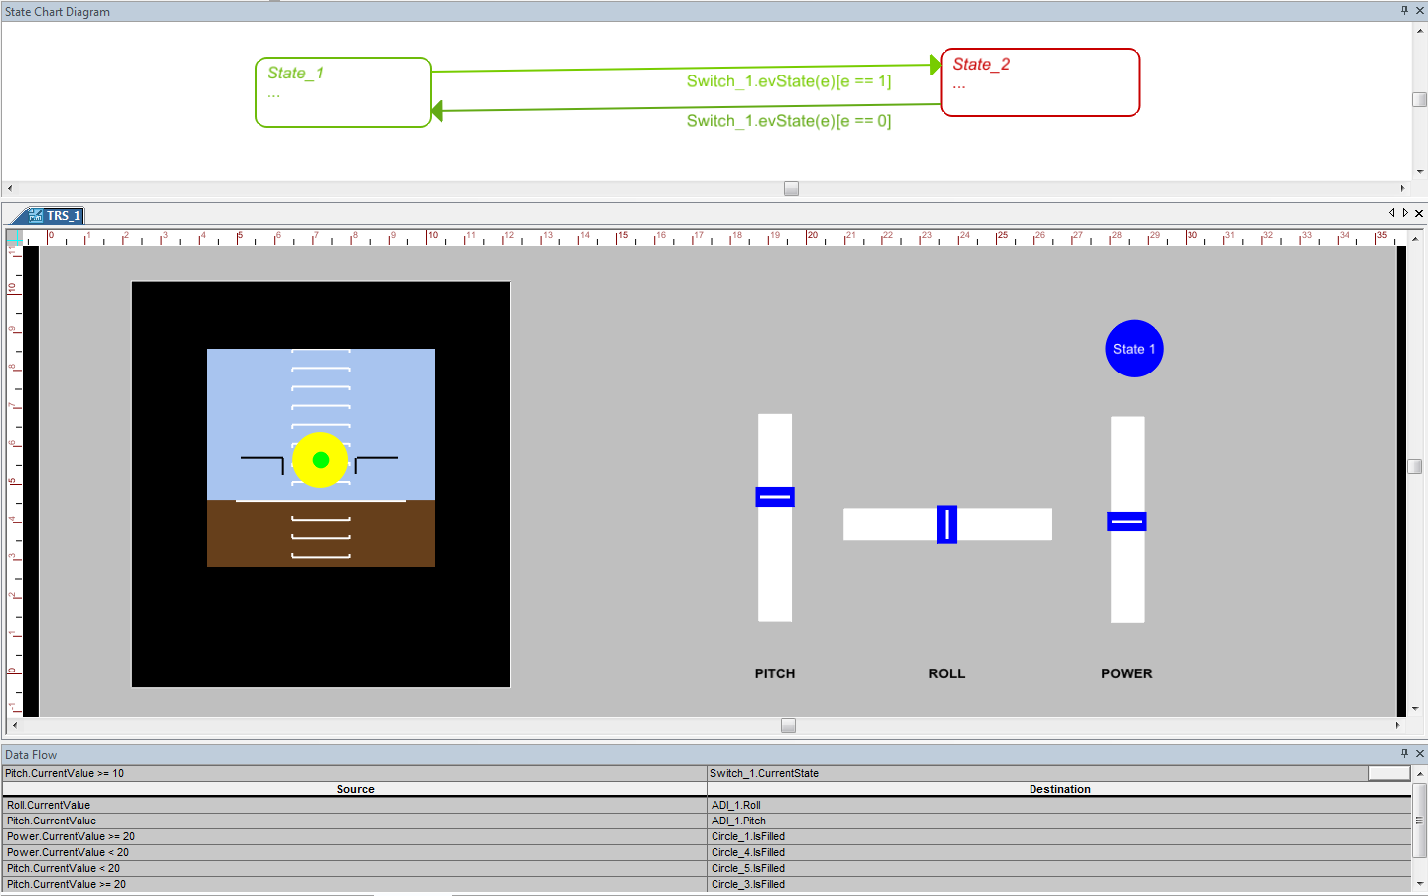
Prototype Design: TRS mode
Notes:
TRS mode adjusting the pitch
Red inner circle turns blue

Slide 17
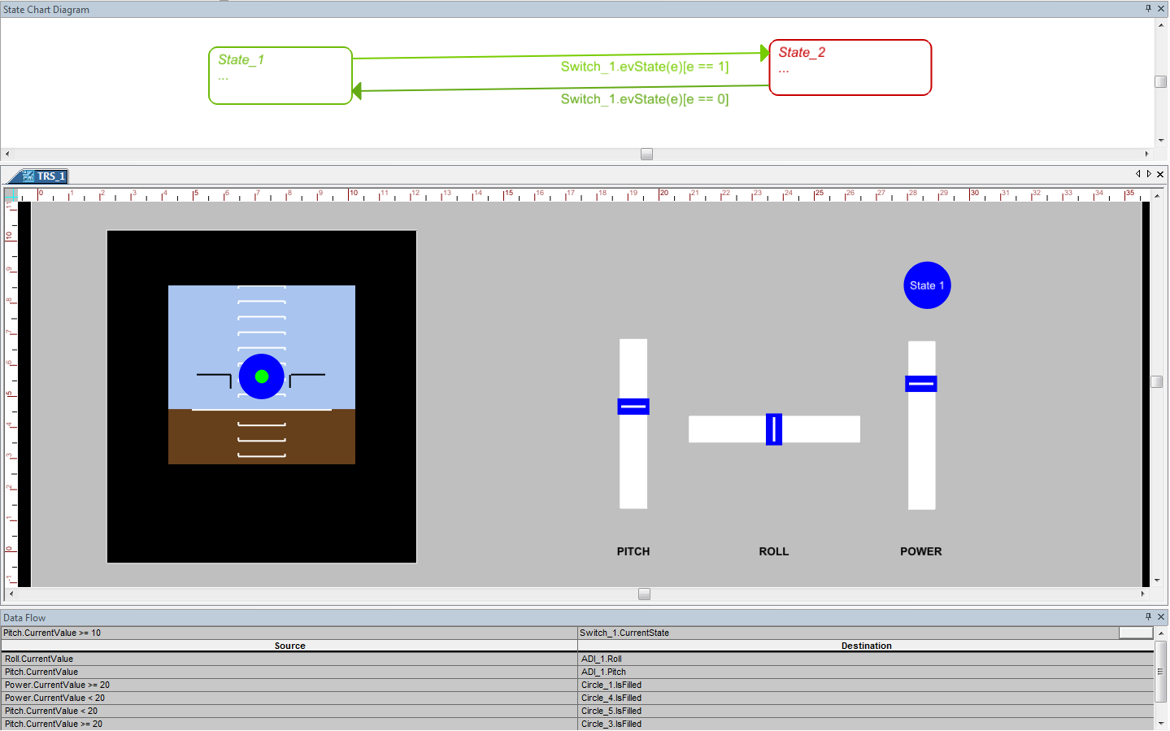
Prototype Design: TRS mode
Notes:
TRS mode
Adjusting the power
Yellow outer circle turns blue

Slide 18
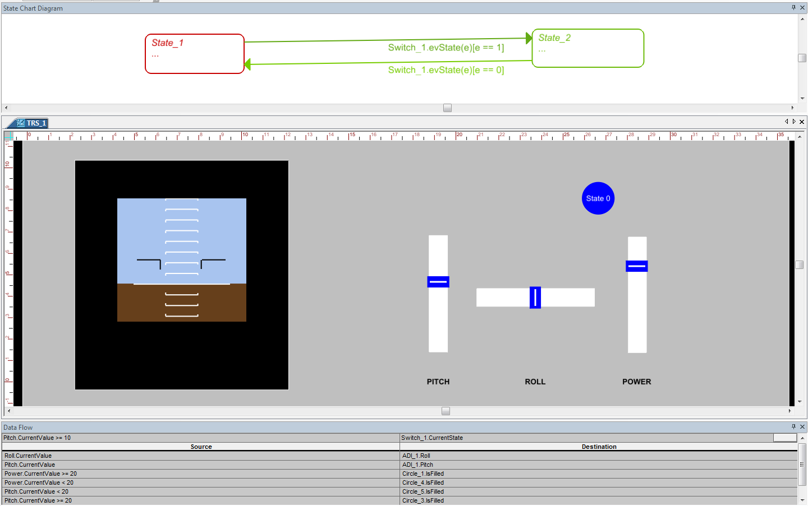
Prototype Design: Normal State
Notes:
Back to normal state.

Slide 19
Next Steps + Priorities? (tbd…)
Dynamic models / equations
Complete display elements…
Interaction (Joystick, etc.)

Slide 20
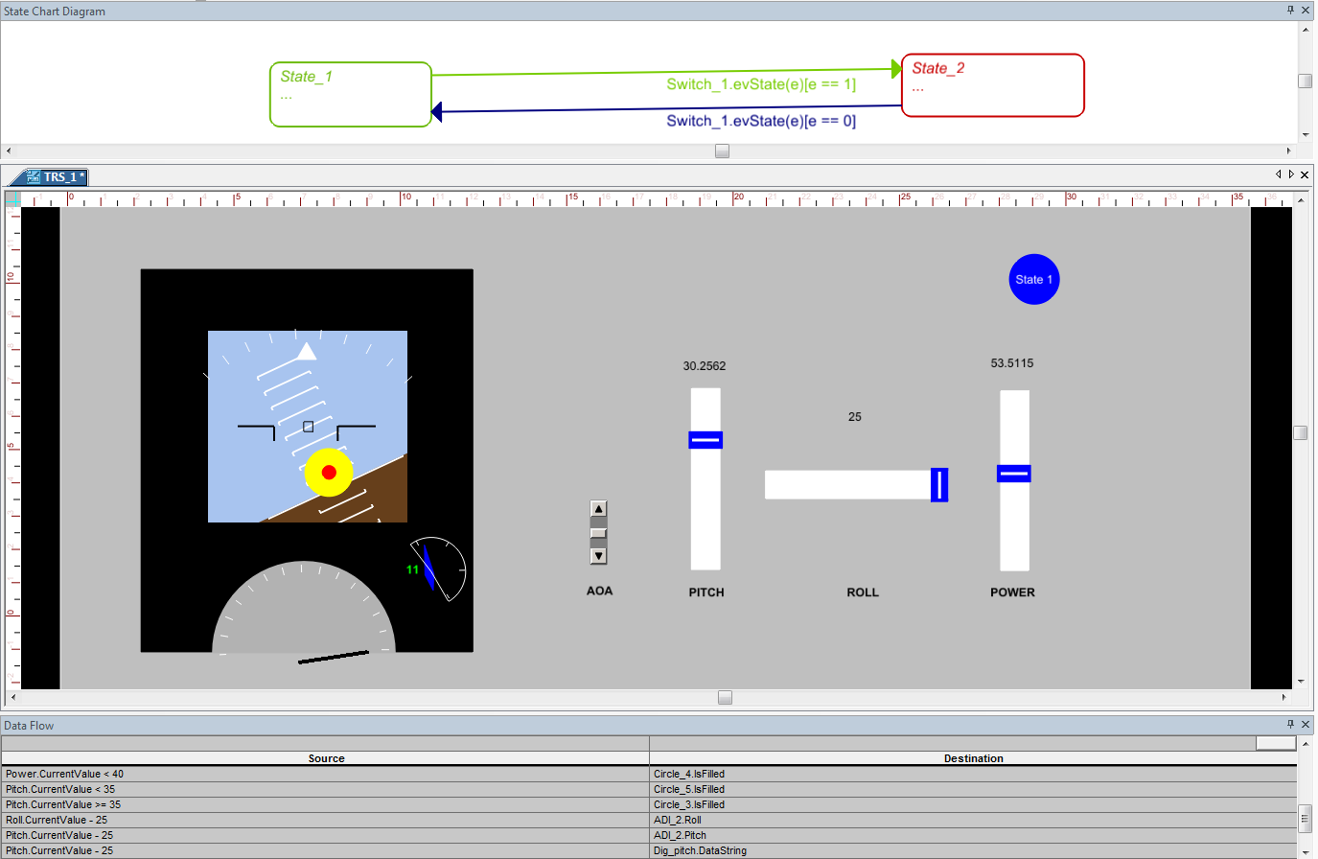
Prototype Design: 3rd state
Notes:
In the 2nd state the TRS target was fixed b/w the pitch bars
According to Nic’s design it should be free and can be at any point in the horizon.
This 3rd state implements this requirements
This design has TRS target free, and this design also has an AOA gauge with the a slider and a digital indicator

Slide 21
Testing Scenarios
STATE 1: Normal State
  Pitch: 3
  Roll: 0
  Power appropriate for sustained flight
  AOA 7
  Display Normal
Notes:
This is design is tested with some scenarios which are give by Nic.
1st scenario is:

Slide 22
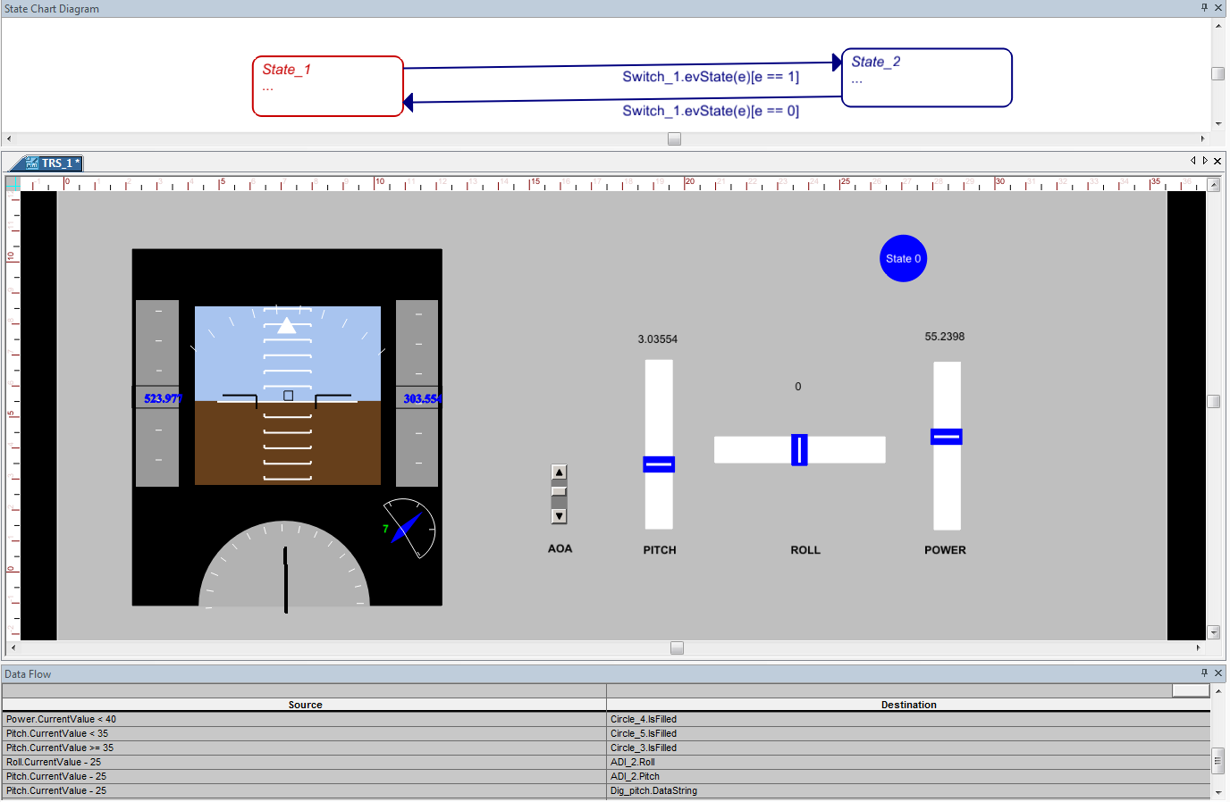
Prototype Design: Normal mode
Notes:
Pitch: 3
Roll: 0
Power appropriate for sustained flight
AOA 7
Display Normal

Slide 23
Testing Scenarios
STATE 2: Aircraft Perturbation
  Trigger Eventing :The aircraft is perturbed for some reason (e.g. wake turbulence from an overtaking jet 1000 feet above)
  The context is characterized by surprise
  Pitch - 15
  Roll+60
  Power is inappropriate due to nose low attitude ( speed is building)
  AOA 5
  Display Normal
Notes:
Testing 2nd scenario
wake turbulence from an overtaking jet 1000 feet above

Slide 24
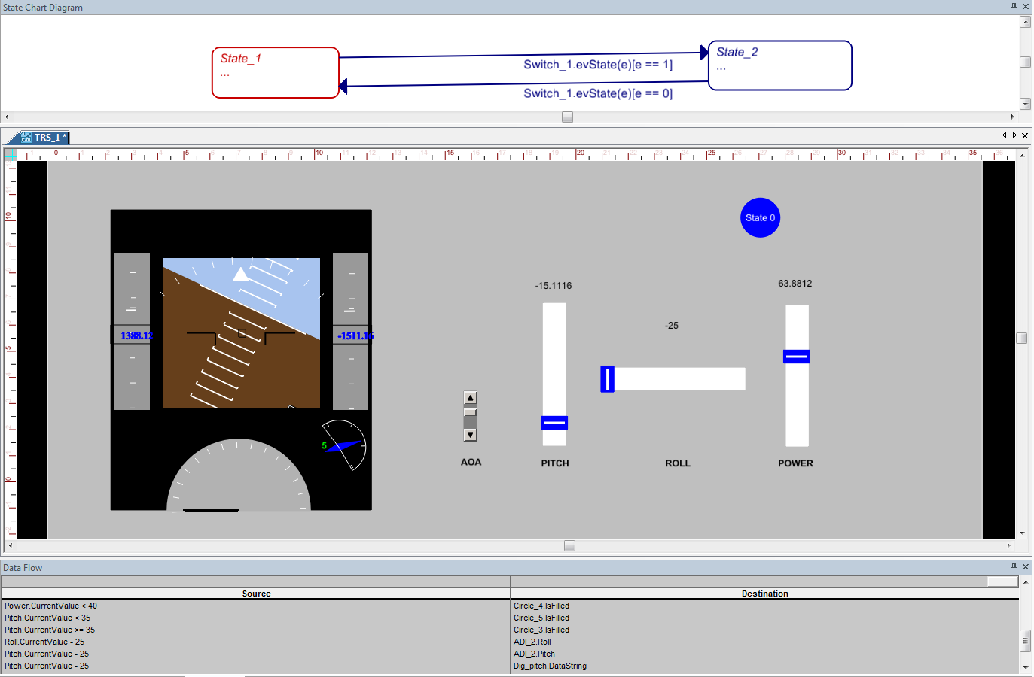
Prototype Design: Aircraft Perturbation
Notes:
Pitch - 15
Roll+60
Power is inappropriate due to nose low attitude ( speed is building)
AOA 5
Display Normal

Slide 25
Testing Scenarios
STATE 3A: Aircraft Nearing Critical Angle of Attack
  TRIGGERING EVENT: Inappropriate and prolonged pilot input
  CONTEXT: The context is chartered by disorientation
  Pitch: + 30 degrees
  Roll: Left 45 degrees
  Power: low power setting
  AOA of 11 with a critical AOA of 12 (point of stall)
Notes:
Aircraft Nearing Critical Angle of Attack
TRIGGERING EVENT: Inappropriate and prolonged pilot input

Slide 26
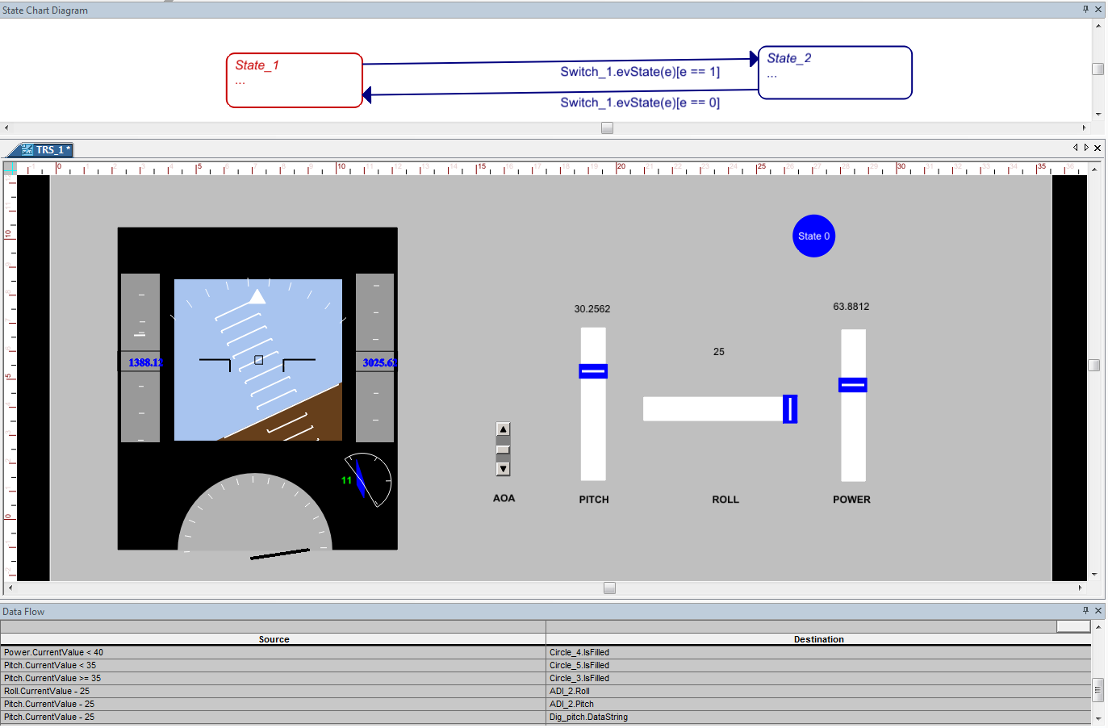
Prototype Design: Aircraft Nearing Critical AOA
Notes:
Pitch: + 30 degrees
Roll: Left 45 degrees
Power: low power setting
AOA of 11 with a critical AOA of 12 (point of stall)

Slide 27
Testing Scenarios
STATE 3B TRS Activation State (SAME AS 3A)
  Display: TRS activated: removal or speed and altitude tapes and annunciation of "TRS MODE” to the left and right of PFD
  Red diamond commanding a :pitch and roll match”
  Yellow ring indicate power too low and commanding increase in power
Notes:
TRS Activation State

Slide 28
Prototype Design: TRS Activation State
Notes:
TRS state
AOA reached critical AOA
Red inner color indicates to reduce the pitch
Yellow outer circle indicated to increase the power (thrust to the engines)

Slide 29
Testing Scenarios
State 3C: Recovery State
  Once pilot lowers nose to match pitch TRS diamond; and rolls aircraft to match circle, color turns green,
  Yellow ring remains until power setting is appropriate

Slide 30
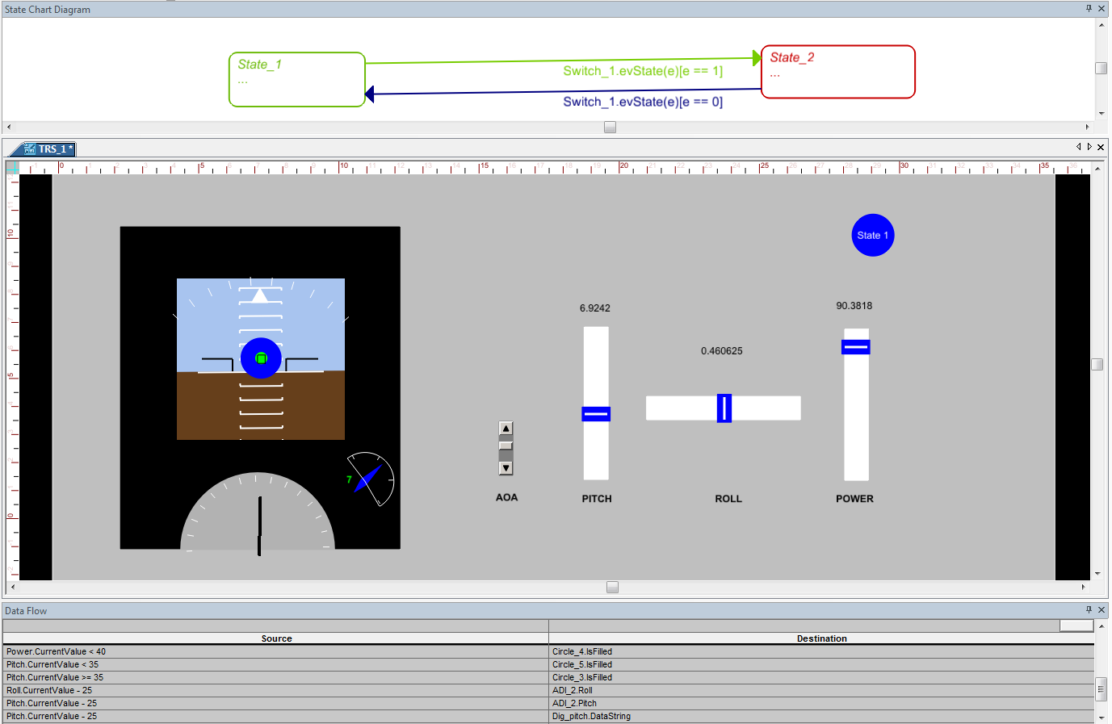
Prototype Design: Recovery State
Notes:
The pitch is reduced red inner turns to green indicating a safe pitch to recover from stall’
The power is increases, yellow outer turned to blue
AOA reduced to 7
Recovers from stall

Slide 31
Testing Scenarios
STATE 4;: Normal State
  Pitch: 3
  Roll: 0
  Power appropriate for sustained flight
  AOA 7
  Display Normal
Notes:
Recovers from stall state to normal state.

Slide 32
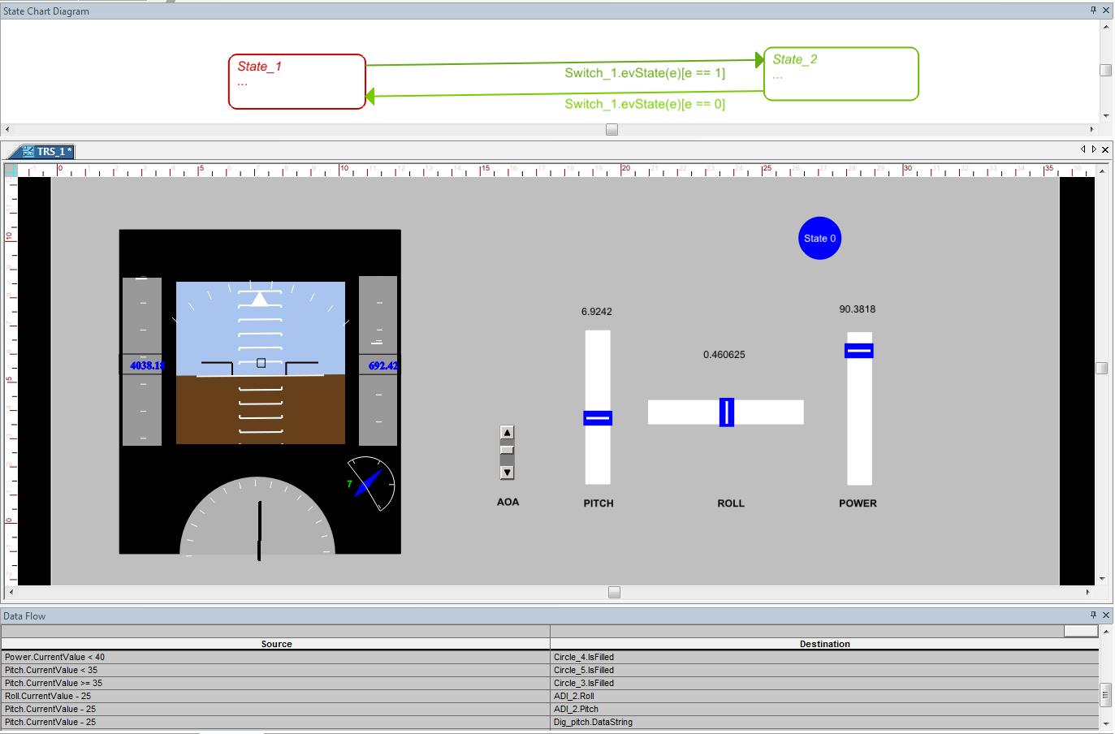
Prototype Design: Normal State
Notes:
Normal state with AOA 7.

Slide 33
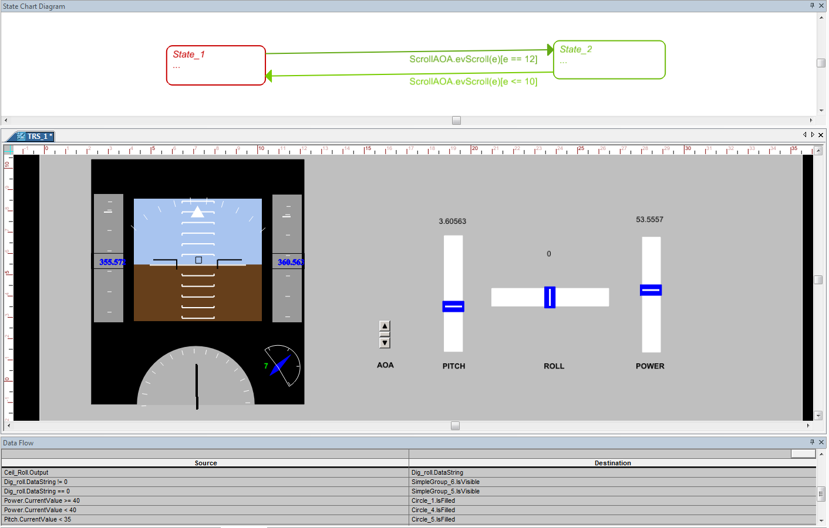
Prototype Design: Design 4
Notes:
In this design automation is involved to switch b/w the normal and TRS state with the help of state cahrt diagram
The switch is removed and the AOA is used as trigger to move b/w the modes
If AOA exceeds 12 then the state changes from normal to TRS mode
If the AOA decreases beyond 7, the TRS mode changes to normal mode
This mode is interactive with the roll
It has roll indiaction

Slide 34
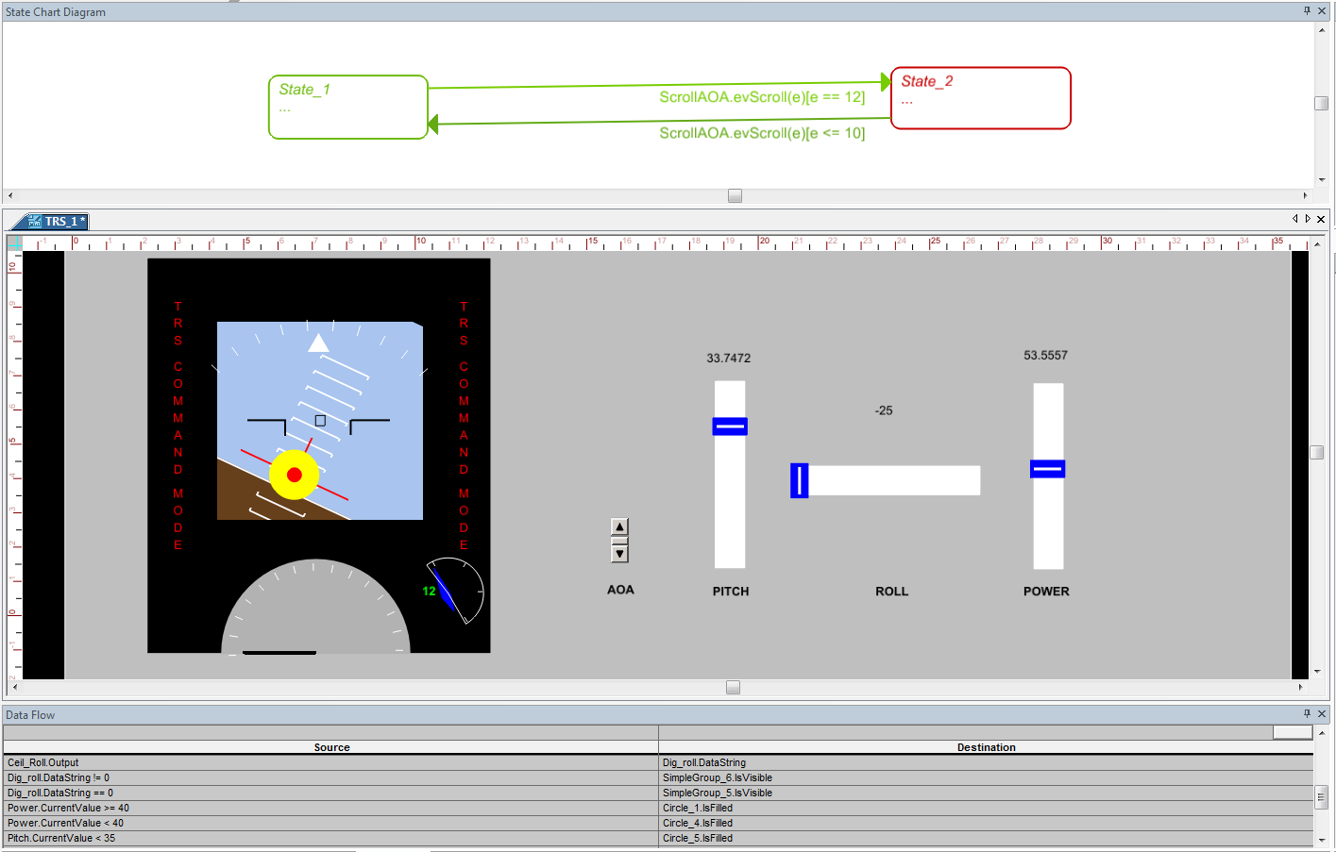
Prototype Design:
Notes:
TRS mode, roll indicator guides the pilot to stabilize the flight
Remaining is same
This design also indicates the TRS command mode on both left and right side of FDR.

Slide 35
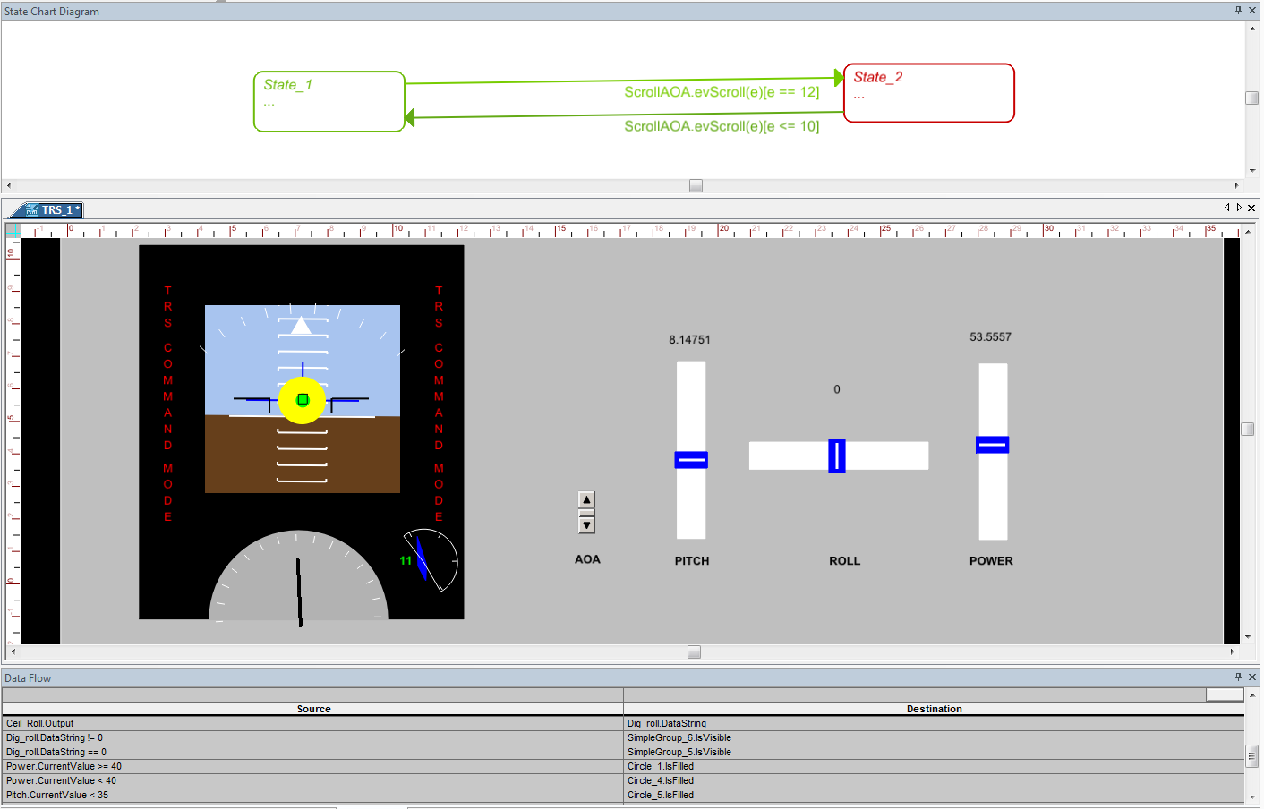
Prototype Design:
Notes:
Desired roll is acquired, lines changes from red to blue
Desired pitch is acquired and inner red circle changes to blue

Slide 36
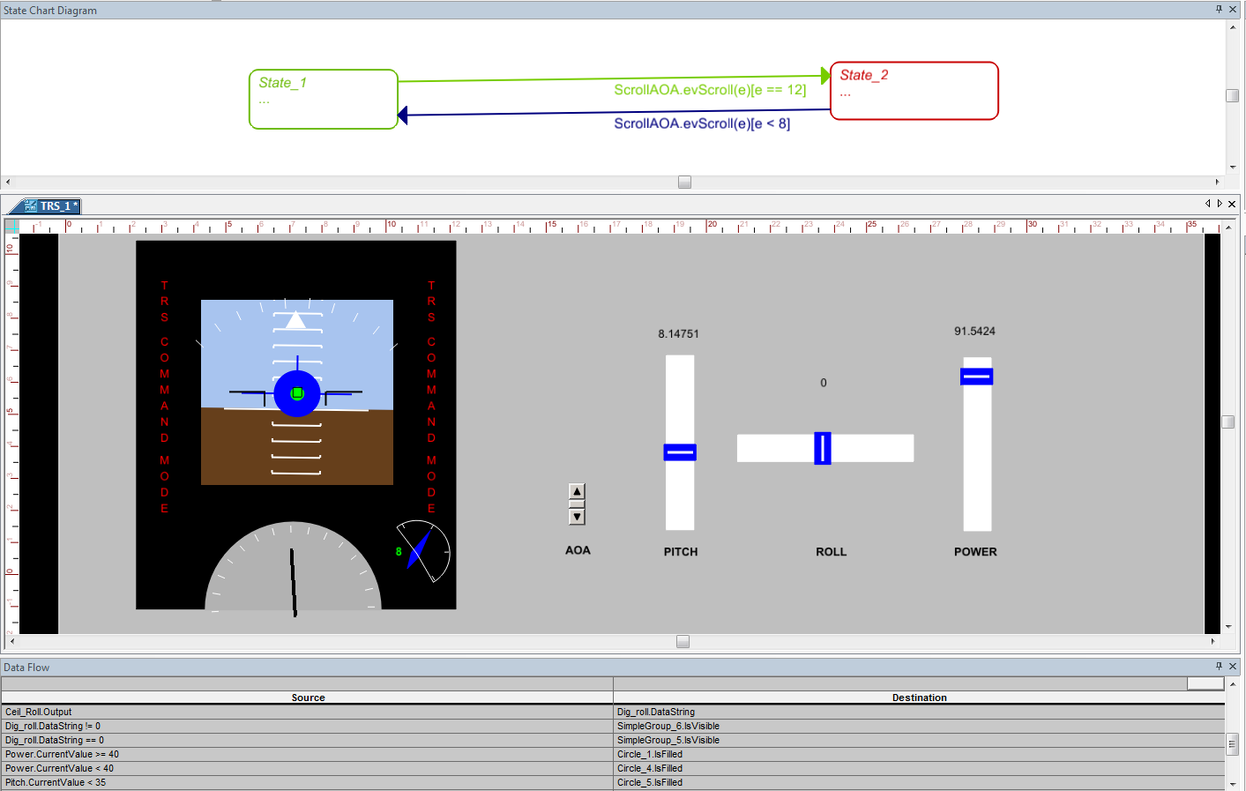
Prototype Design:
Notes:
The desired power is acquired, the outer yellow circle changes to blue.

Slide 37
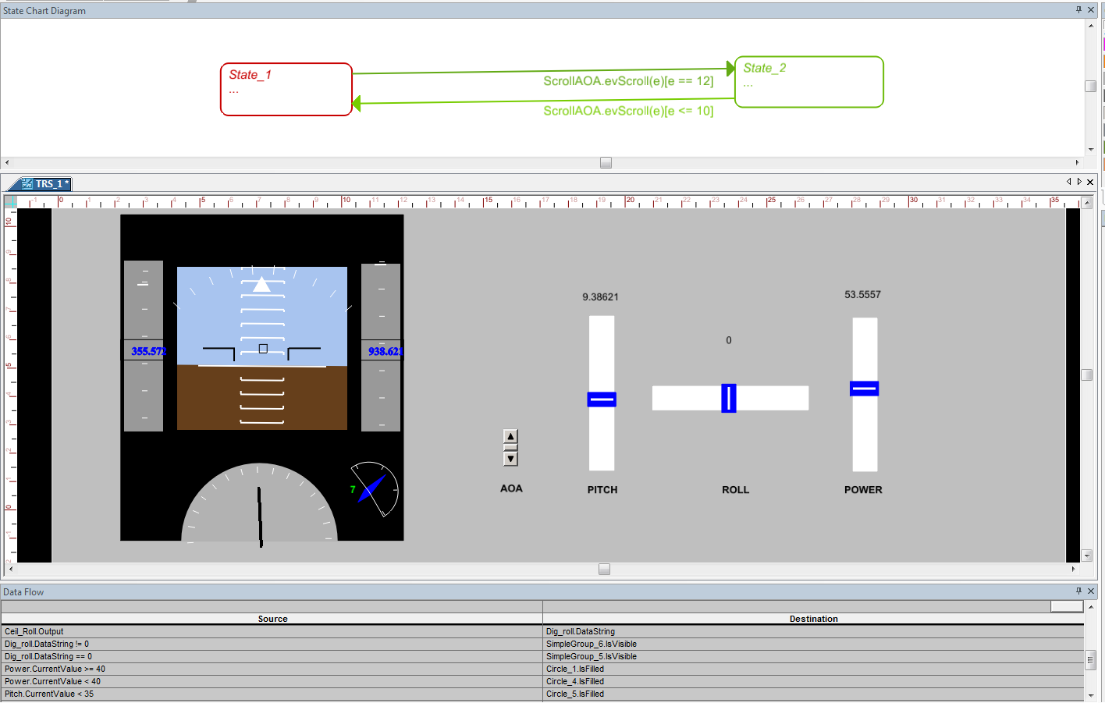
Prototype Design:
Notes:
The flight is recovered from the stall mode
As the AOA is reduced to 7, the state changes from TRS mode to normal mode

Slide 38
Future Work: (as Discusses)
Change in Attractor
  Color change (green instead of red)
  Size (according to attributes)
  Shape (triangle, square, ellipse)
    Regular Vs stretch
Notes:
This design is when the flight high above the ground and with no obstacles underneath .
If the flight is just above the ground, this design needs some other modification at this situation.
With a discussion with Dr. lucas and Nic, led to changes and new designs
Changes in attractor
Color, red can be used instead of green to reduce the complexity for the pilot
Size of the TRS target, depending on the situation, if the roll to left is more than the TRS target stretches to left more, vice versa.
Shape also needs change to reduce the complexity for the pilot.

Slide 39
Future Work:
Integrating joystick to the design
  Saitek X-55
    fully programmable drivers
    enhanced 16-bit hall-effect sensors in the axis
    swappable springs for the joystick
    twin lockable throttles
Boeing Simulator integration
Notes:
Integration with joystick (Saitek x-55)
And boeing simulator which is present in ……(next room)

Slide 40
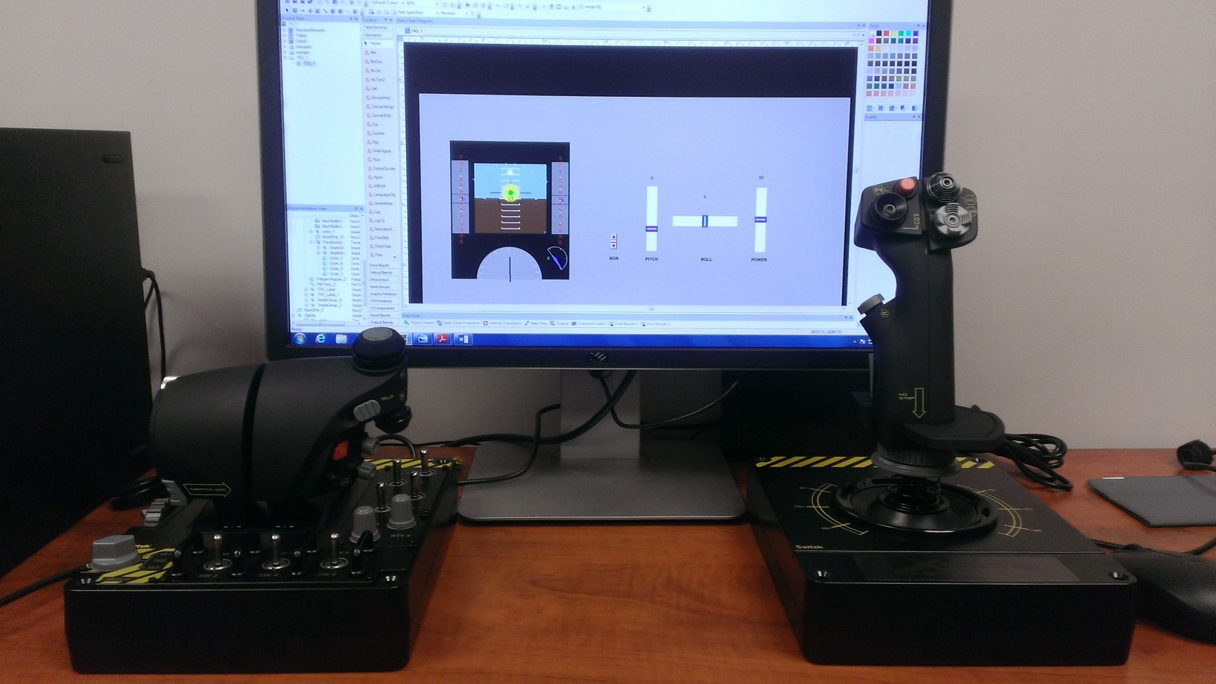
Future Work:
Notes:
This the integration pic of Saitek X-55 with the design
It has:
fully programmable drivers
enhanced 16-bit hall-effect sensors in the axis
swappable springs for the joystick
twin lockable throttles

Slide 41
Future Work:
Integration with the Boeing Simulator
  Software: Prepar3D
  Testing
  Real time scenarios
Notes:
Integration of the design with the simulator to test the design with the real time scenarios
And the simulator works on Prepar3D s/w from Microsoft.
This also gives the parameters that are going to be involved with the design which may lead to enhancement of the design.

Slide 42
Reference:
Trajectory Recovery System AIM/ODM Solutions – Nicholas Kasdaglis.
S. Jacobson. "Aircraft loss of control causal factors and mitigation challenges," in Anonymous 2010, Available: http://dx.doi.org/10.2514/6.2010-8007. DOI: doi:10.2514/6.2010-8007.

